Slide 1

Presentation on CO2 emission by vehicles
Group members: Sneh Shah (DS-30)
Himanshu Thakkar(DS-33)
Kashish Pandya(DS-16)
Department of emerging science and technology

Slide 2
Outline
Definition
Objective
Introduction
Project Workflow
Methodology
Results
Conclusion
References

Slide 3
Definition
CO2 emissions are considered one of the leading causes of environmental impact in megacities and their dangerous effects on human health.
Therefore, it becomes important for us to deeply understand and analyse the causes of air pollution in our surroundings.
So, we will be seeing the information related with emission of CO2 due to certain vehicles.

Slide 4
Objective
In this project, we explored the features by statistical distributions to find any outliers or skewness.
We tried to find the relationship between vehicles and CO2 emission , Fuel consumption by vehicles and CO2 emission.
Used algorithms to predict the CO2 emission.
Obtain accuracy for given models.

Slide 5
Introduction
The dataset used captures the details of how CO2 emissions by a vehicle can vary with the different features.
This contains data over a period of 7 years.
There are total 7385 rows and 12 columns.
There are few abbreviations that has been used to describe the features. Which are shown in upcoming slides

Slide 6
Project Workflow
Data Collection
Data Preprocessing
Feature Engineering
Data Modelling

Slide 7
Data Collection
We collect the data from Kaggle.
The dataset has been taken from Canada Government official open data website. This is a compiled version. This data contains following information:
Make= Company of the vehicle
Model= Car model
Vehicle Class= Class of vehicle depending on their utility, capacity and weight
Engine Size = Size of engine used in Litre
Cylinders= Number of cylinders
Transmission = Transmission type with number of gears

Slide 8
Data Collection
Fuel type =Type of Fuel used
Fuel Consumption Comb=The combined fuel consumption (55% city, 45% highway) is shown in L/100 km
Transmission A = Automatic AM = Automated manual AS = Automatic with select shift AV = Continuously variable M = Manual
Fuel type X = Regular gasoline Z = Premium gasoline D = Diesel E = Ethanol (E85) N = Natural gas

Slide 9
Data Preprocessing
First we found duplicate value
There were 1103 duplicated values there was an option of keeping it but we decided to remove it .
There were no null values in the dataset
Our data is numerical and categorical data.

Slide 10
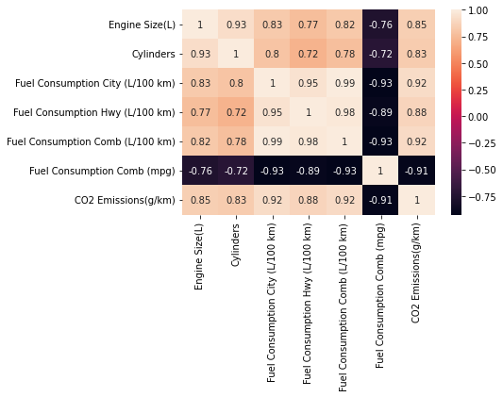
Correlation between numerical data

Slide 11
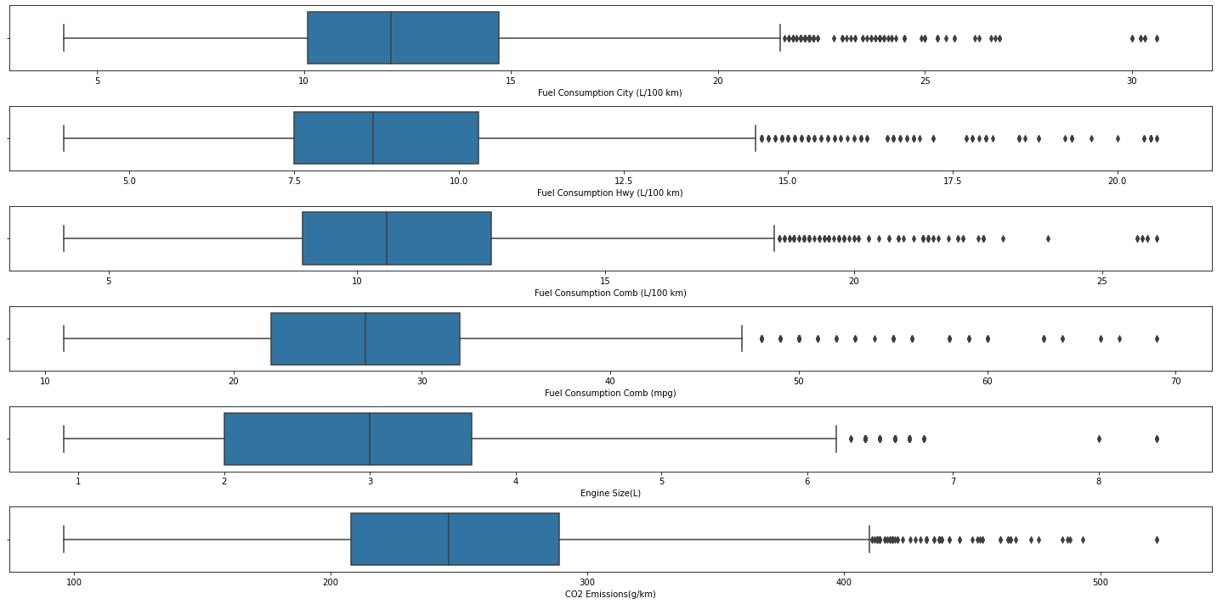
Box plot of numerical data

Slide 12
Feature Engineering
Since each categorical feature has a strong relationship with Emission so we should use ordinal encoding
Ordinal Encoder help to convert categorical data into numerical value We will not convert ‘Model’ as we are dropping the feature later
An ordinal encoding involves mapping each unique label to an integer value. This type of encoding is only appropriate if there is a known relationship between the categories.
This relationship does exist for some of the variables in our dataset, and ideally, this should be harnessed when preparing the data.

Slide 13
Feature Engineering
Standard scaler is also used in the dataset ,as our data has multi-collinearity
Standard scaler transforms the data in such a manner that it has mean as 0 and standard deviation as 1.
It standardizes the data. It arranges the data in a standard normal distribution.
After standarscaler the multicollinearity has been nearly removed

Slide 14
Data Modelling
We used MULTIPLE LINEAR REGRESSION and POLYNOMIAL REGRESSION
X = Make, Vehicle Class, Transmission, Fuel Type, Engine Size(L), Cylinders, Fuel Consumption Comb (L/100 km)
Y= CO2 emission
Multiple regression is a statistical technique that can be used to analyze the relationship between a single dependent variable and several independent variables.
The objective of multiple regression analysis is to use the independent variables whose values are known to predict the value of the single dependent value.

Slide 15
Data Modelling
Polynomial regression of degree 3 is used
Polynomial Regression is generally used when the points in the data are not captured by the Linear Regression Model and the Linear Regression fails in describing the best result clearly.

Slide 16
Result
Mean absolute error =
mean absolute error (MAE) is a measure of errors between paired observations expressing the same phenomenon.
In multiple linear regression mean absolute error is 13.00987073094198.
In polynomial regression mean absolute error is 2.4448953833557834

Slide 17
Result
Mean squared error =
the mean squared error (MSE) of an estimator (of a procedure for estimating an unobserved quantity) measures the average of the squares of the errors that is, the average squared difference between the estimated values and the actual value.
In multiple linear regression mean squared error is 349.0226443336937
In polynomial regression mean squared error is 10.1300489353158502

Slide 18
Result
Root mean square error =
Root mean square error (RMSE) is a frequently used measure of the differences between values (sample or population values) predicted by a model, or an estimator and the values observed.
The RMSE represents the square root of the second sample moment of the differences between predicted values and observed values.
In multiple linear regression root mean square error is 18.68214774413514
In polynomial regression root mean square error is 3.182842967090664

Slide 19
Result
multiple linear regression =
Our test accuracy is 0.8946711089955147
Our Train accuracy is 0.8901842018901868
polynomial regression(degree=3) =
Our test accuracy is 0.9972991242243856
Our train accuracy is 0.9973933310405038

Slide 20
Conclusion
We create some new data(acura,compact,AS5,z,2,4,8.5) and predict it.
In multiple linear regression our prediction of co2 emission is 202(g/km).
In polynomial regression our prediction of co2 emission is 197(g/km).
The data actual value of co2 emission is 196(g/km)
We can see that accuracy in polynomial regression is quite more than the multiple linear regression
Complexity of the model also increases which can lead to overfit of the data but there is no overfitting or underfitting of the data

Slide 21
References
https://www.nationalobserver.com/2019/09/04/analysis/canadian-cars-are-worlds-dirtiest-ev-age-essential
https://www.canada.ca/en/environment-climate-change/services/environmental-indicators/greenhouse-gas-emissions.html
https://open.canada.ca/data/en/dataset/98f1a129-f628-4ce4-b24d-6f16bf24dd64#wb-auto-6
https://www.kaggle.com/debajyotipodder/co2-emission-by-vehicles

Slide 22
THANK YOU

